Slide 1
Derivatives and Gradients

Slide 2
Derivatives
Derivatives tell us which direction to search for a solution

Slide 3
Derivatives
Slope of Tangent Line

Slide 4
Derivatives

Slide 5
Derivatives in Multiple Dimensions
Gradient Vector
Hessian Matrix

Slide 6
Derivatives in Multiple Dimensions
Directional Derivative

Slide 7
Numerical Differentiation
Finite Difference Methods

Slide 8
Numerical Differentiation: Finite Difference
Derivation from Taylor series expansion

Slide 9
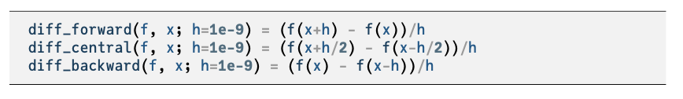
Numerical Differentiation: Finite Difference
Neighboring points are used to approximate the derivative
h too small causes numerical cancellation errors

Slide 10
Automatic Differentiation
Evaluate a function and compute partial derivatives simultaneously using the chain rule of differentiation

Slide 11
Automatic Differentiation
Forward Accumulation is equivalent to expanding a function using the chain rule and computing the derivatives inside-out
Requires n-passes to compute n-dimensional gradient
Example

Slide 12
Automatic Differentiation
Forward Accumulation

Slide 13
Automatic Differentiation
Forward Accumulation

Slide 14
Automatic Differentiation
Forward Accumulation

Slide 15
Automatic Differentiation
Reverse accumulation is performed in single run using two passes over an n-dimensional function (forward and back)
Note: this is central to the backpropagation algorithm used to train neural networks
Many open-source software implementations are available

Slide 16
Summary
Derivatives are useful in optimization because they provide information about how to change a given point in order to improve the objective function
For multivariate functions, various derivative-based concepts are useful for directing the search for an optimum, including the gradient, the Hessian, and the directional derivative
One approach to numerical differentiation includes finite difference approximations

Slide 17
Bracketing

Slide 18
Bracketing
Identifying an interval containing a local minimum
and
then successively shrinking that interval

Slide 19
Unimodality
There exists a unique optimizer x* such that f is monotonically decreasing for x ≤ x* and monotonically increasing for x ≥ x*

Slide 20
Finding an Initial Bracket
Given a unimodal function, the global minimum is guaranteed to be inside the interval [a,c] if

Slide 21
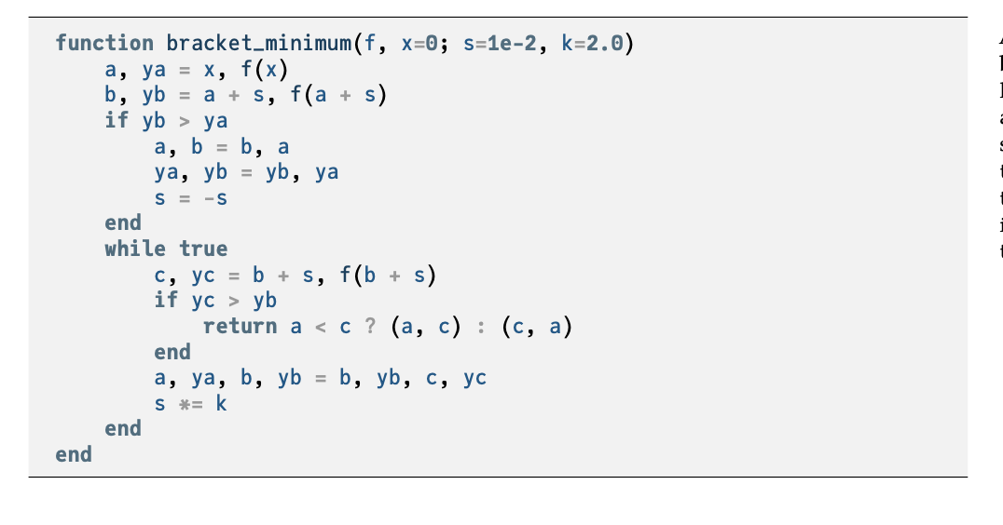


Slide 22
Finding an Initial Bracket
Example bracketing sequence

Slide 23
Fibonacci Search
When function evaluations are limited, the Fibonacci Search algorithm is guaranteed to maximally shrink the bracketed interval

Slide 24
Fibonacci Search
When restricted to two function evaluations, compare

Slide 25
Fibonacci Search
When restricted to three function evaluations

Slide 26
Fibonacci Search
When restricted to n function evaluations

Slide 27

Fibonacci Search
Binet’s formula defines a Fibonacci number analytically where φ is the Golden Ratio, φ=(1+$√5)/2≈1.61803$
The ratio between successive Fibonacci numbers is
where $s=\frac{1−\sqrt{5}}{1+\sqrt{5}}≈−0.382$

Slide 28
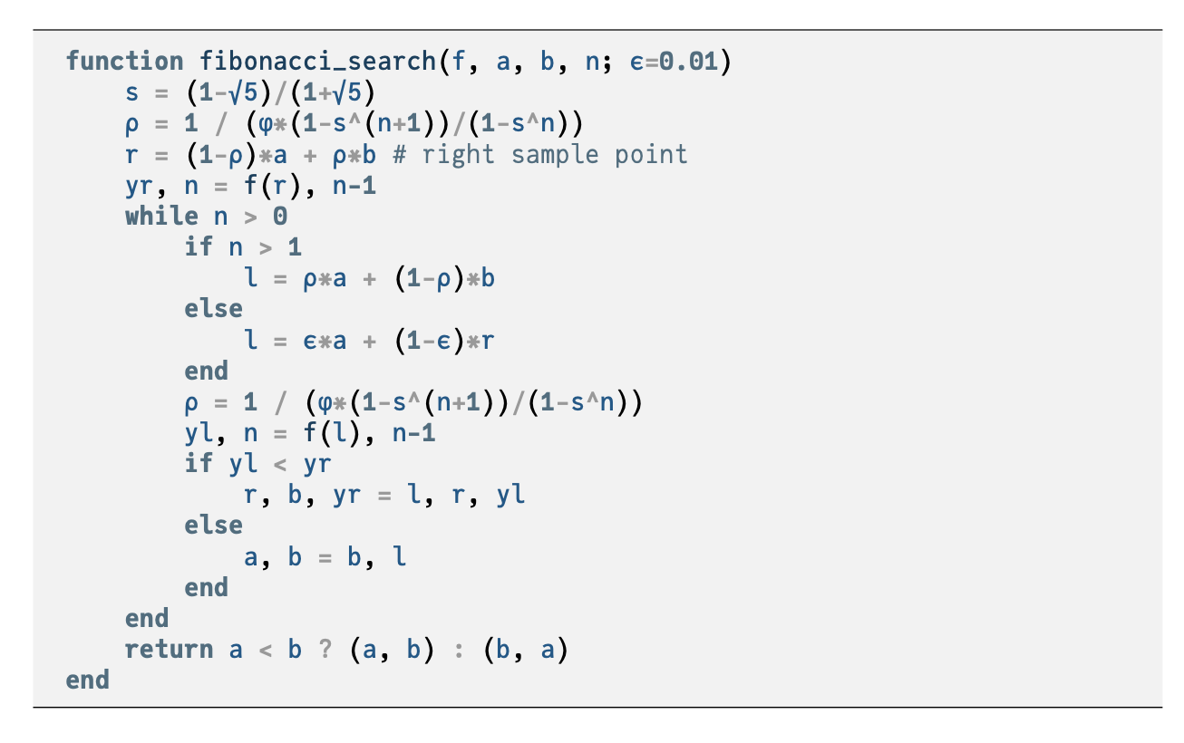

Slide 29
Quadratic Fit Search
Leverages ability to analytically minimize quadratic functions
Iteratively fits quadratic function to three bracketing points

Slide 30
Quadratic Fit Search
If a function is locally nearly quadratic, the minimum can be found after several steps

Slide 31
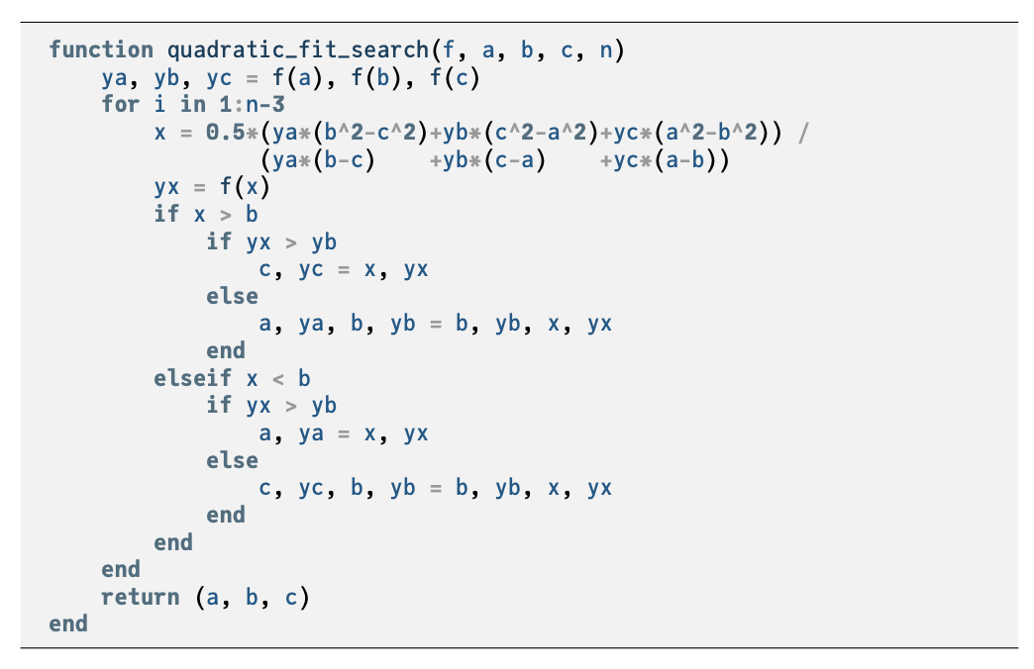

Slide 32
Summary
Many optimization methods shrink a bracketing interval, including Fibonacci search, golden section search, and quadratic fit search

Slide 33
Local Descent

Slide 34
Descent Direction Iteration
Descent Direction Methods use a local model to incrementally improve design point until some convergence criteria is met
Check termination conditions at x^{(k)}; if not met, continue.
Decide descent direction d^{(k)} using local information
Decide step size α^{(k)}
Compute next design point x^{(k+1)}

Slide 35
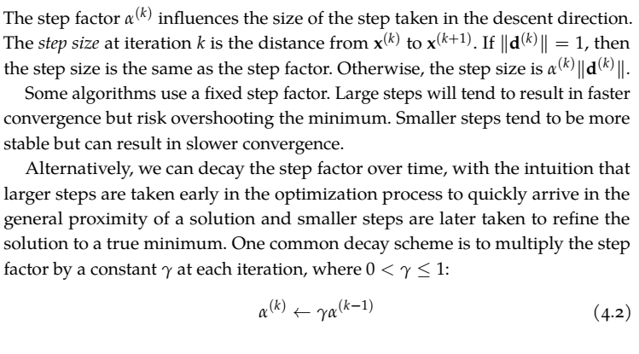

Slide 36
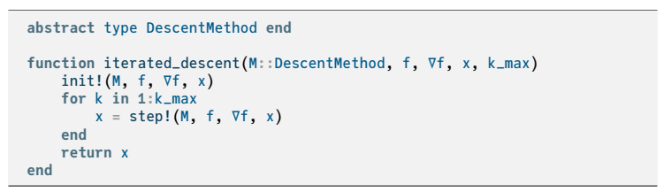


Slide 37
Line Search
Used to compute α
Using the techniques discussed in Chapter 3,
Often this is computed approximately to reduce cost

Slide 38
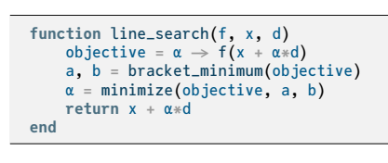

Slide 39
Line Search: Alternatives
Fixed α called learning rate
Decaying step factor
Decaying step factor is often required in convergence proofs

Slide 40

Approximate Line Search
If function calls are expensive, rather than finding the minimum along a search direction, find a point of sufficient decrease
β∊[0,1], usually β=1$×$10⁻⁴
Backtracking line search starts with a large step and then backs off

Slide 41
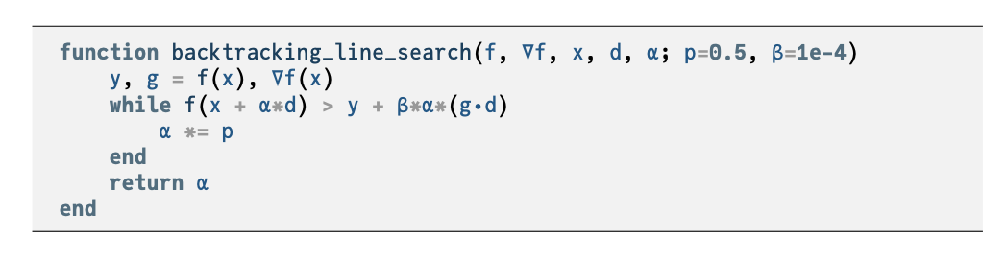

Slide 42
Approximate Line Search
Building on backtracking line search are the Wolfe Conditions
First Wolfe Condition: Sufficient Decrease
Second Wolfe Condition: Curvature Condition

Slide 43
Termination Conditions
Maximum Iterations
Absolute Improvement

Slide 44
Termination Conditions
Relative Improvement
Gradient Magnitude

Slide 45
Summary
Descent direction methods incrementally descend toward a local optimum.
Univariate optimization can be applied during line search.
Approximate line search can be used to identify appropriate descent step sizes.
Termination conditions for descent methods can be based on criteria such as the change in the objective function value or magnitude of the gradient.

